Slide 1
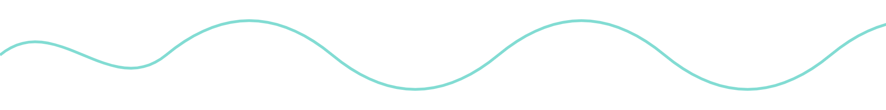
Mindball
TEAM KICKOFF · AUTUMN 2026
Recreating a brain-controlled game, then building our own
Notes:
Welcome everyone. Quick intro to the project, how we’re organized, and what to do this week.

Slide 2

What is Mindball?
Two players wear EEG headsets. The ball rolls away from whoever is more relaxed.
Measure
Score
Move
Electrodes record each player’s brain activity
Brain rhythms become a relaxation score
The ball rolls toward the less relaxed player
Notes:
The calmer player wins. Trying hard to win makes you tense, which makes you lose. That tension is what makes the game fun.

Slide 3
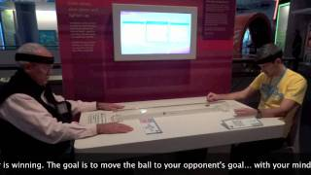
Recreate Mindball, understand how it works, then build our own brain-controlled games.
OUR GOAL
Notes:
Understanding both the neuroscience and the code is the point, not just getting a ball to move.

Slide 4
Team Structure
Split into subgroups focused on specific tasks (details later in presentation)
Meetings roughly every week to go over progress, assign tasks, etc.
Reach out if you run into bugs

Slide 5
How we work: Phase 1
Split into sub-groups focused on short term tasks, and finish the core Mind Game.
EEG Data Acquisition & Hardware Integration: Reading EEG data from OpenBCI headsets, streaming it into Python, and managing recordings.
Signal Processing & Focus Index: Analyzing brainwave frequencies and developing a method to estimate player focus.
Artifact Detection & EEG Cleaning: Identifying and filtering noise from eye blinks, muscle movements, and other sources.
Game Logic & Scoring: Designing scoring algorithms, win conditions, and the core game engine.
Arduino Communication & LED Display: Connecting Python to Arduino and developing the LED-based game display.
Pretrained EEG Models & ML Research: Exploring pretrained models such as REVE and CBraMod for focus prediction and future minigames.
Notes:
No separate neuro and build teams. Every group goes from research to a working build.

Slide 6



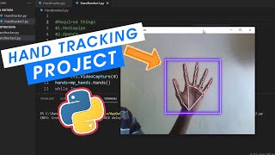
Long term plans: Phase 2
Everyone makes/executes minigame ideas in small groups. Some potential ideas are:
Visual Effects
Associating EEGs to potential visual effects on a screen telepathy style
Tug of war
Red Light Green Light
Tug of war between two players
Intense amounts of focus and then no focus
Notes:
No separate neuro and build teams. Every group goes from research to a working build.

Slide 7
The plan
WEEKS 1–3
WEEKS 4–5
WEEK 6 ON
END OF YEAR
Learn & build
Create Prototypes/Only MindBall
Finish MindBall
Showcase
Figure out the different data and software and hardware everyone will be using
Get MindBall fully fleshed out and working
Live Mindball and every game on showcase
Create prototypes of MindBall, and other potential minigames depending on progress
Notes:
The code itself is small. Most of the work is testing whether our score really measures relaxation. Games are developed on recorded data, so the single headset only matters for live testing.

Slide 8
How we’ll form groups
A short form asks
Every group gets
How comfortable are you with coding? (1–3)
How much neuroscience background do you have? (1–3)
A confident coder
Someone with a neuro background
A mix of experience levels
Groups can reshuffle in week 4, when we pick mini-games.
Notes:
The first groups are for learning. The second groups are for interest, so people can move to the game they’re most excited about.

Slide 9
General Project Workflow
EEG Scan
Process Signal
Calculate Game State
Display on Arduino/Hardware
Calibrate EEGs and detect brain waves, transferring information to computer
Take raw EEG data from both players and interpret it into focus index or some quantifiable metric that continuously changes over time, sending metric to game state script
From the processed signal, update the game state and send information to hardware
Display game state on hardware (ex: LED strip showing current advantage)

Slide 10
Group 1 — EEG Data Acquisition & Hardware Integration
Goal: Establish a reliable pipeline for obtaining EEG data in Python.
Understand the Ultracortex Mark IV, electrode positions, and Cyton + Daisy board.
Learn how to use BrainFlow to stream raw EEG into Python.
Understand the 16-channel, 125 Hz data format.
Investigate how to stream data from two headsets simultaneously, including board/dongle requirements and interference.
Develop a system for buffering incoming EEG into rolling windows.
Investigate recording, timestamping, and replaying EEG data for testing.
Determine how to detect headset disconnections and dropped samples.
Initial deliverable: A Python script that streams or replays EEG data, displays basic signal information, and saves recordings for other groups.
Starting resources:
OpenBCI Cyton + Daisy documentation (https://docs.openbci.com/Cyton/CytonSDK/)
BrainFlow supported boards (https://brainflow.readthedocs.io/en/stable/SupportedBoards.html)
BrainFlow Python examples (https://brainflow.readthedocs.io/en/stable/Examples.html)

Slide 11
Group 2 — Signal Processing & Focus Index
Goal: Determine how to estimate player focus directly from EEG recordings.
Understand EEG frequency bands, particularly theta, alpha, and beta.
Research how to calculate band powers using FFT or Welch's power spectral density method.
Investigate filtering, referencing, and which electrodes to use for focus estimation.
Research EEG engagement indices, including beta / (alpha + theta).
Compare different methods of calculating a focus index, including BrainFlow's built-in concentration metric.
Investigate calibration and normalization so players with different EEG baselines can compete fairly.
Experiment with different window sizes and smoothing techniques.
Define experiments to evaluate whether the focus index responds consistently to different cognitive tasks.
Initial deliverable: A function that takes an EEG window and returns a focus estimate, plus an explanation of the chosen method and its limitations.
Starting resources:
OpenBCI Band Power and Focus widgets (https://docs.openbci.com/Software/OpenBCISoftware/GUIWidgets/)
BrainFlow signal-processing examples (https://brainflow.readthedocs.io/en/stable/Examples.html)
MNE-Python documentation (https://mne.tools/stable/auto_tutorials/preprocessing/index.html)

Slide 12
Group 3 — Artifact Detection & EEG Cleaning
Goal: Prevent muscle movements, eye blinks, and noisy electrodes from affecting the game.
Understand common EEG artifacts, especially EMG (muscle activity) and EOG (eye movements).
Investigate how jaw clenching, blinking, and head movement affect beta-band power and focus estimates.
Research simple artifact-detection techniques using amplitude, variance, and other signal characteristics.
Investigate Artifact Subspace Reconstruction (ASR).
Investigate ICA and pretrained artifact classifiers such as ICLabel.
Evaluate whether artifact-removal methods are suitable for real-time processing at 125 Hz
Compare rejecting contaminated windows against attempting to reconstruct clean signals.
Define a signal-quality indicator that other components can use to pause scoring when necessary.
Initial deliverable: A basic artifact-detection or quality-checking function, with comparisons between clean EEG and recordings containing deliberate movements.
Starting resources:
MNE-ICALabel (https://mne.tools/mne-icalabel/stable/)
ASRpy (https://github.com/DiGyt/asrpy)
MNE preprocessing tutorials (https://mne.tools/stable/auto_tutorials/preprocessing/index.html)

Slide 13
Group 4 — Game Logic & Scoring System
Goal: Develop the core game mechanics independently of EEG hardware.
Design how two players' focus estimates translate into changes in score.
Research how to account for different individual focus baselines.
Decide how frequently scores should change and how to prevent unstable score fluctuations.
Implement continuous score tracking over time.
Design win conditions, such as reaching a certain score advantage or sustaining a lead for a specified duration.
Define how the game responds to unreliable EEG readings or disconnected headsets.
Build a Python simulation that generates artificial focus values to test gameplay.
Consider how game logic can be made modular for future minigames.
Initial deliverable: A working Python game engine that accepts two simulated focus values, updates the game state, and detects a winner.
Starting resources:
Python dataclasses (https://docs.python.org/3/library/dataclasses.html)
Python unittest (https://docs.python.org/3/library/unittest.html)

Slide 14
Group 5 — Arduino Communication & LED Display
Goal: Translate the current game state into a physical LED display.
☐ Understand how Python communicates with an Arduino over USB serial.
☐ Investigate PySerial and how to send score updates.
☐ Research possible LED layouts for representing the competition.
☐ Determine the commands and data format needed between Python and Arduino.
☐ Implement different LED states for scoring, game start, winner announcement, and errors.
☐ Experiment with smooth LED transitions and animations.
☐ Investigate how to recover from interrupted serial communication.
☐ Design the interface so different minigames can reuse the display.
Initial deliverable: An Arduino display controlled by simulated score updates from Python.
Starting resources:
PySerial documentation (https://pyserial.readthedocs.io/en/latest/)
PySerial short introduction (https://pyserial.readthedocs.io/en/latest/shortintro.html)
Arduino documentation (https://docs.arduino.cc/)

Slide 15
Group 6 (Optional) — Pretrained EEG Models & Future ML Research
Goal: Investigate whether pretrained EEG models could improve our current focus estimation and support future minigames.
This group is more exploratory and is not required for the first working prototype.
Research general-purpose EEG foundation models, primarily CBraMod and REVE.
Understand what representations these models produce and how to use them for downstream predictions.
Investigate how to adapt pretrained models to our 16-channel OpenBCI configuration.
Research resampling our 125 Hz EEG recordings to the 200 Hz inputs expected by these models.
Investigate whether pretrained models can estimate focus without extensive additional training.
Research available datasets for attention, relaxation, cognitive workload, and motor imagery.
Investigate how to train lightweight task-specific prediction heads on top of a shared EEG encoder.
Benchmark memory usage and inference latency on available hardware.
Compare pretrained-model approaches against the simpler band-power baseline.
Initial deliverable: A comparison of promising models, their inputs and outputs, hardware requirements, and how we could adapt them to Mind Games. A small inference demo would be valuable if feasible.
Starting resources:
CBraMod GitHub (https://github.com/wjq-learning/CBraMod)
REVE project (https://brain-bzh.github.io/reve/)
Braindecode (https://braindecode.org/stable/)
MOABB — EEG benchmark datasets (https://moabb.neurotechx.com/)

Slide 16
Where our project will be hosted
1
2
We will host all of our information on our github repo (this just means project page)
Required Software:
Python
Git
VSCode
https://github.com/Synaptech-MindGames/Mind-Games
Notes:
Share the form link and the Discord and GitHub invites here.

Slide 17
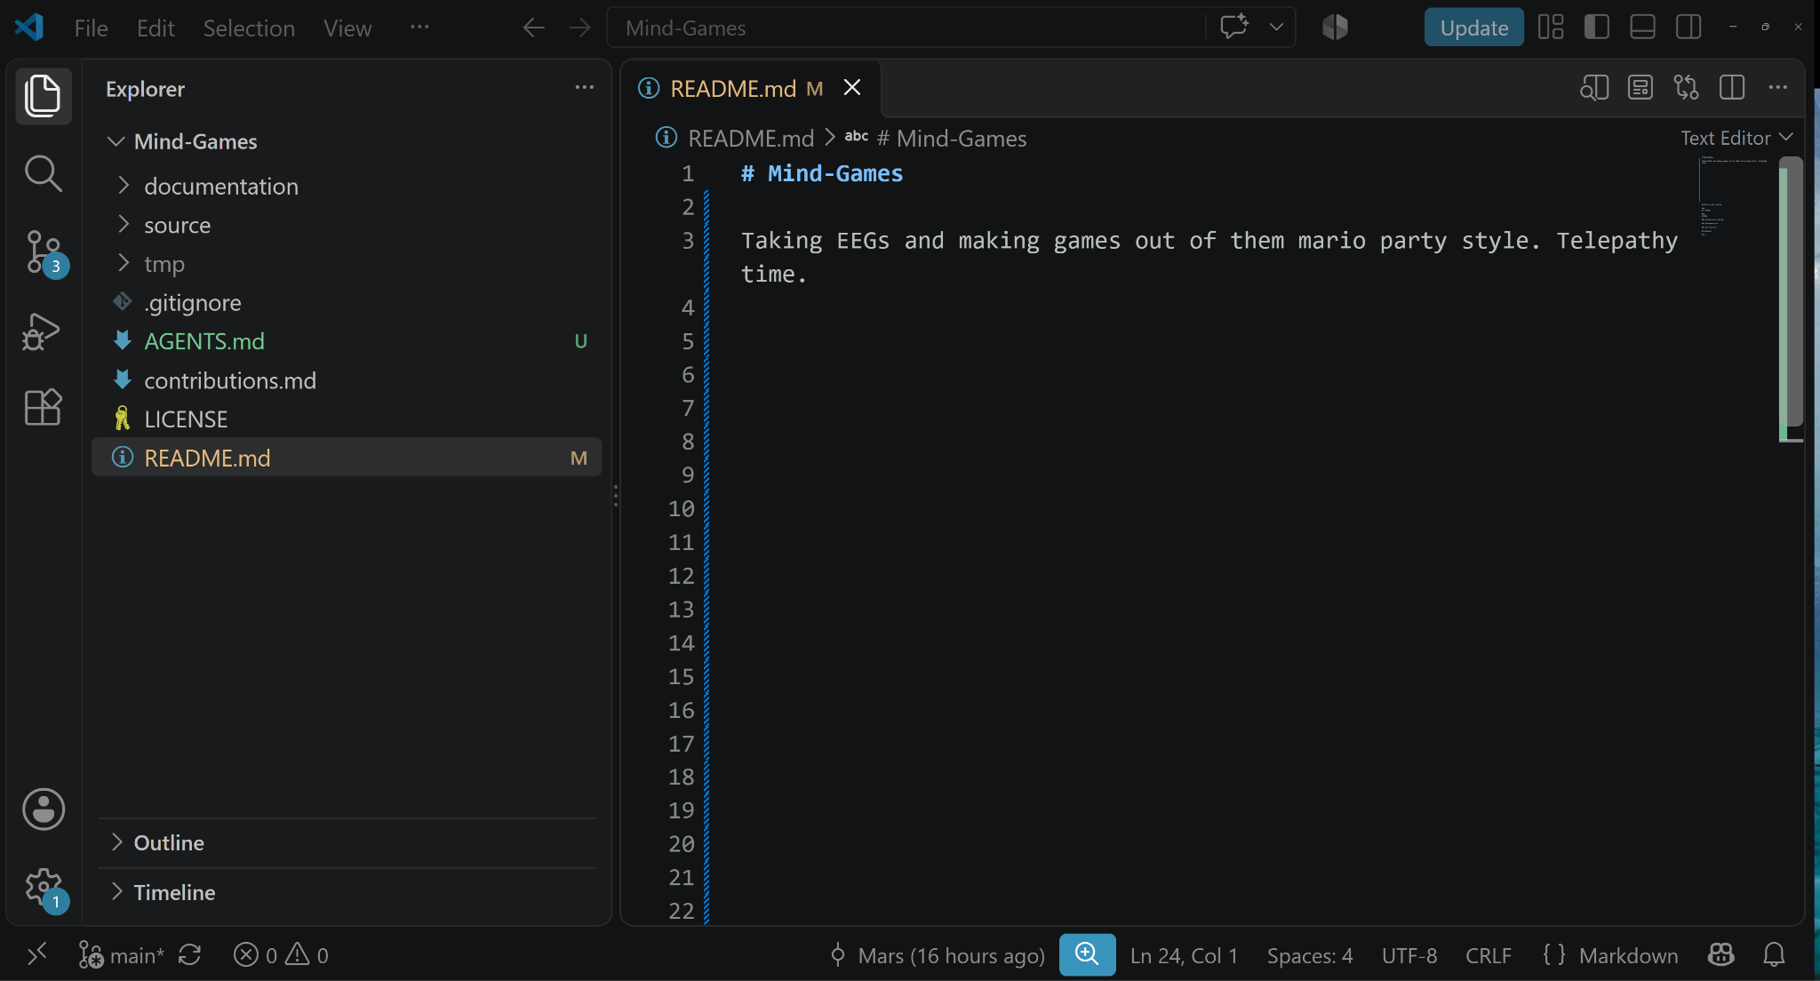
VSCode
Allows you to view the project data and use AI Agents through extensions (Claude, Codex, etc.) easily
https://code.visualstudio.com/download
Notes:
Share the form link and the Discord and GitHub invites here.

Slide 18
Git
Purpose
PR Requests + Branches
Download
Allows you to get all recent changes from team members (git), and work within your subteams on a ‘branch’ and push all your changes onto the main branch all subteams are working based off of.
After changing/adding to a file, a ‘PR Request’ from your teams ‘branch’ will be made. This is basically a spot where your changes will be reviewed before being added to the main repo on Github.
https://git-scm.com/install/

Slide 19
Python
Allows you to run/make the program
Easiest language to work with, and very easy for AI agents to use…
https://www.python.org/downloads/release/python-31318/
Notes:
Share the form link and the Discord and GitHub invites here.

Slide 20
AI Resources
1
2
3
ChatGPT Plus: 4 months free for eligible U.S. college/grad students. Claim by October 31, 2026. Renews at $20/month afterward.
Tip: Put on a locked virtual credit card and use unofficial transcript/tuition statement. UW ID doesn’t work.
https://chatgpt.com/students/2026/
Google AI student offer: 12 months free. In the U.S., this is Google AI Pro; other supported regions may get a different Google AI plan. Claim by December 31, 2026.
Tip: Put on a locked virtual credit card
https://gemini.google/students/
OpenAI Codex for Students: $100 in Codex credits for verified university students in the U.S. and Canada. Credits expire 12 months after grant
https://developers.openai.com/community/students
Notes:
Share the form link and the Discord and GitHub invites here.

Slide 21
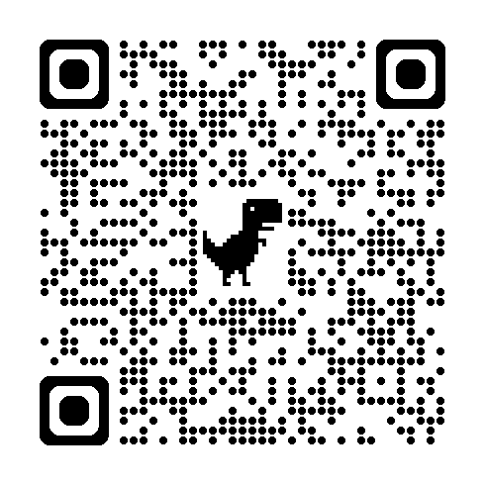
Before next week
1
2
Fill out the groups form
Install Python + Git
Notes:
Share the form link and the Discord and GitHub invites here.

